Slide 1
SmartCare
QA TESTING
ASSISTANT
PLATFORM
QA Testing Assistant
Platform
HIPAA-Compliant · Microsoft Presidio · Azure AI Foundry · Azure DevOps · CI/CD Ready
PHI Sanitization
3 Features
(No AI needed)
5+ AI Features
(With Foundry)
100% HIPAA Compliant
M K Vishnukumar
VP-QA
Notes:
Looks good

Slide 2
PHI Sanitization Layer — Microsoft Presidio
KEY ARCHITECTURE: ADO data fetched FIRST → THEN sanitized by Presidio→ ONLY then sent to AI. ONE Presidio layer only.
1
User sends prompt
2
Fetch RAW data from ADO
3
Presidio sanitizes
4
Sanitized data → GPT-4o
5
Output sanitized again
6
Safe response to user
→
→
→
→
→
Masking Examples — Deterministic (same input = same dummy output, always)
Patient Name
SSN
Date of Birth
John Smith → Test Patient A
123-45-6789 → XXX-XX-0001
01/15/1985 → 01/01/2000
Email
MRN
Phone
john@hosp.com → test@dummy.com
MRN-88421 → ID-DUMMY-001
555-123-4567 → 555-000-0001
Built with: Python · Microsoft Presidio (Open Source) · Faker · SHA-256 Hashing · FastAPI · Audit Logging (HIPAA)

Slide 3
SmartCare QA Testing Assistant — Solution Overview
What It Does
One chat interface for all QA users — backed by ADO, Presidio, and Azure AI Foundry
✅ WORKS Without AI
⏳ WITH AZURE AI FOUNDRY
Test Case Lookup
Generate Test Cases
Enter any ADO ID → fetch → Presidio sanitize → safe data returned
Tester describes scenario in plain English → AI generates structured test cases for ADO upload
Automation Scripts
Coverage Gaps
Provide test case → AI writes Selenium Java script following team coding standards
Find all User Stories with NO linked test cases — instant ADO WIQL query
User Guides
Select ADO requirements → AI generates formatted user guide content
Sprint Summary
All work items for current sprint, sanitized — safe to share in any meeting
Test Plan Summary
AI reads full test plan → plain English summary of coverage, gaps, risks

Slide 4
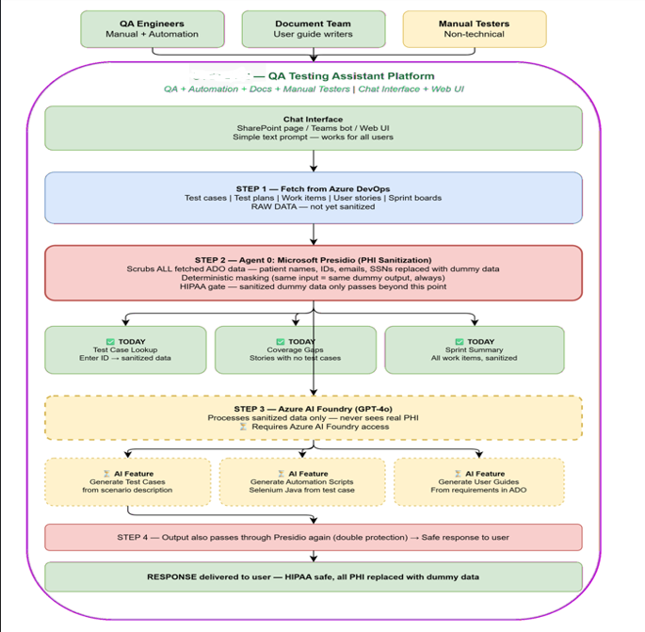





Slide 5
Deployment — Dockerization, Containerization & CI/CD Pipeline
CI/CD Pipeline — Azure DevOps
Code Push
(ADO Repo)
Build
(Docker)
Test
(pytest)
Push Image
(ACR)
Deploy
(Container Apps)
Health
Check
→
→
→
→
→
Option A — Azure Cloud (RECOMMENDED)
Option B — On-Premises
POC Phase
Docker Container
Azure App Service Free Tier
• No Docker needed • Free URL: yourapp.azurewebsites.net
• HTTPS enforced • Zero cost for demo
FastAPI app packaged as Docker image
Runs on any VM — Linux or Windows Server
Gateway
Production
NGINX or Kong behind internal firewall
Handles routing, auth, SSL termination
Azure Container Apps
• FastAPI packaged as Docker container
• Auto-scales on demand • Azure APIM for auth + routing
• ~$50-150/month moderate usage
Hosting
Company VM + Docker Compose
No cloud dependency — fully internal
Scale (if needed)
AKS (Kubernetes)
• Only if 10+ microservices needed
• Full orchestration • Dedicated DevOps engineer required
Limitation
Manual setup takes weeks vs hours on Azure
No auto-scaling — fixed capacity planning needed

Slide 6
Observability — Monitoring, Logging & Audit Trail
Why Observability is Non-Negotiable for Healthcare AI
HIPAA requires a complete audit trail of every access to patient-related data. Every API call, ADO fetch, Presidio detection, and LLM call must be logged.
What Must Be Logged (HIPAA Requirement)
Monitoring Technology
● Every API request — timestamp, user ID, endpoint, status code
Azure Application Insights
✅ RECOMMENDED
Request tracking, performance monitoring, live metrics stream, failure analysis. Free up to 5GB/month.
● Every ADO data fetch — work item ID, fields accessed, who requested it
● Every Presidio detection — entity type detected, hash of original value (NOT the value itself)
Azure Monitor
✅ RECOMMENDED
● Every LLM call — prompt hash, token count, model used, response time
Centralized monitoring across all Azure services. Alerts, dashboards, log queries.
● Every authentication event — login, logout, failed attempts
● Every RBAC decision — access granted or denied, role used
Splunk / ELK Stack
⏳ Phase 3
Enterprise-grade log aggregation and analysis. Advanced HIPAA audit reporting at scale.
Caching Strategy — Reduces ADO load and Azure OpenAI cost
Test case details
15 min
Coverage gap analysis
30 min
Sprint work items
5 min
LLM responses
1 hour
Very frequent reads — rarely changes
Expensive ADO query — slow-changing
Changes during active sprints
Same prompt = same answer = big cost saving

Slide 7
Tools & Technology Stack
Core Engine (Already Developed ✅)
API & Microservice Layer
Gateway & Routing
Python 3.11+ (Core implementation)
FastAPI (Open Source — Build service)
Azure API Management / APIM (Auth, throttling, routing — Licensed)
Microsoft Presidio (PII/PHI detection — Open Source MIT)
Uvicorn / Gunicorn (Run server)
Kong (Open Source alternative)
Faker Library (Deterministic masking)
Docker (Containerization)
NGINX (Open Source — On-prem gateway)
SHA-256 Hashing (Consistent dummy values)
Azure DevOps API (Work item integration)
Azure Cache for Redis
Regex Engine (Custom pattern detection)
LangChain / LangGraph
Azure Foundry
Azure Entra ID (Auth + RBAC — included in M365)
Hosting
Monitoring & Audit Logging
Security
Azure App Service Free Tier (POC — zero cost)
Azure Application Insights (Free up to 5GB/month)
Azure Key Vault (Store PAT + secrets securely — free standard)
Azure Container Apps (Production — PAYG)
Azure Monitor (Centralized dashboards + alerts)
OAuth / Managed Identity (Passwordless auth)
AKS / Kubernetes (Scale phase only)
Splunk / ELK Stack (Enterprise audit — Phase 3)
Private Endpoints (Foundry not exposed to internet)
On-Prem VM + Docker (Fallback option)
Audit Logs (HIPAA traceability — every call logged)
RBAC (Dev cannot see QA data — enforced at Entra ID level)

Slide 8
Implementation Plan — Phased Delivery
Phase 1 — Foundation & POC
Phase 2 — AI Activation
Phase 3 — Production & Scale
✅ ADO connection live and working
⏳ Chat interface fully functional
⏳ Teams bot via Copilot Studio
✅ Presidio (Agent 0) sanitizing all ADO data
⏳ Generate test cases from scenario description
⏳ All QA features fully AI-powered
✅ Test Case Lookup working today
⏳ Generate Selenium Java automation scripts
⏳ Coverage analysis with AI insights
✅ Coverage Gaps working today
⏳ Generate user guides from ADO requirements
⏳ Hospital staff RAG queries
✅ Sprint Summary working today
⏳ Test plan AI summaries
⏳ Azure Container Apps (production hosting)
⏳ Chat interface deployed (App Service Free Tier)
⏳ Azure APIM for auth + routing
⏳ Splunk / ELK Stack audit logging
⏳ Share via web URL — accessible to all QA team
⏳ Azure Monitor + App Insights logging
⏳ Full CI/CD pipeline with automated testing
Deliverable: Working QA features with no AI
Requires: Azure AI Foundry access approval
Full production deployment

Slide 9
Business Value
🔒
Risk Reduction
📜
Compliance
🤖
AI Enablement
Prevent PHI/PII leakage to AI tools. HIPAA-compliant by design — not bolted on. Every request sanitized before AI sees it.
HIPAA, SOC2, GDPR readiness. Complete audit trail of every data access. BAA with Microsoft Azure.
Safe adoption of Azure AI Foundry, GPT-4o, and Copilot tools across the QA team. No PHI risk to AI vendors.
⚡
QA Productivity
🔁
Reusability
📈
Scalability
Test cases generated in seconds. Automation scripts from plain English. Coverage gaps found instantly. Sprint summaries on demand.
One Presidio service used across QA, Dev, and any future system. Central PHI governance layer for the whole organisation.
Works for ADO, logs, emails, documents, any future system. Azure Container Apps auto-scales on demand. No manual capacity planning.

Slide 10
Thank You
Notes:
Looks good

